Slide 1




x
an evening of intrapreneurship
@circleofyi #circleofyi

Slide 2
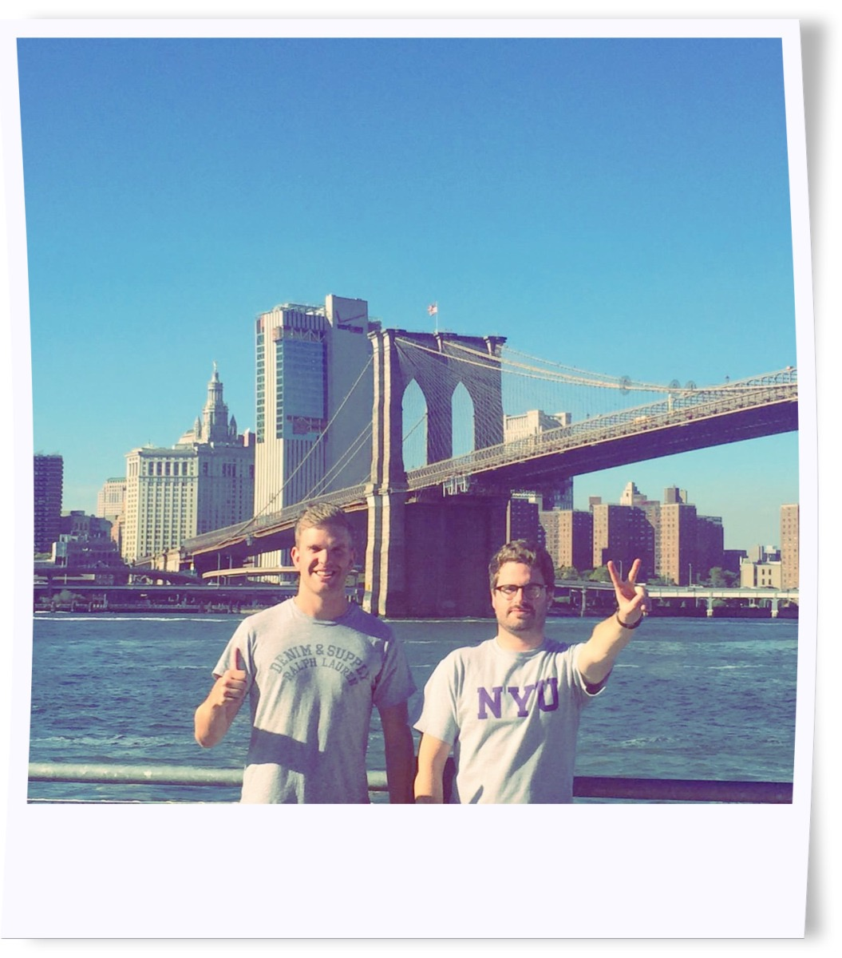
Tim Heard
@tjrhd Tim Heard
David Spears
@davidjspears David J Spears
a
d
a
d
tim & David

Slide 3
social intrapreneur
[noun]: soh-shuh-l in-truh-pruh-nur
a passionate individual, who thinks and acts like a entrepreneur, working inside a major corporation or organisation, who develops and delivers innovative, profitable and sustainable solutions to social or environmental challenges

Slide 4


























welcome to the circle of young intrapreneurs!
HELLO!
we are a movement designed to inspire, guide, develop and deliver purpose-driven business ideas from young social intrapreneurs in large, corporate organisations globally. we’re making business a force for good.
WHO
WE
ARE
circleofyi.com
@circleofyi
WE LAUNCHED IN January 2016 IN LONDON, uk
AND NOW
we have
1000+ members
in
40+ countries
from
300+
orgs
JOIN
US
=
with 10 hubs globally
#1
WE ARE already THE LARGEST NETWORK OF social INTRAPRENEURS anywhere…
SOUND GOOD?
made by @davidjspears © circle of young intrapreneurs 2016

Slide 5
panel session
viviana alvarez (unilever)
lewis smith (johnson and johnson)
matt milligan (ey)
tim heard (barclays)

Slide 6
balls brothers
hays galleria, tooley st, se1 2hd

Slide 7
JOIN US
www.circleofyi.com

